Slide 1
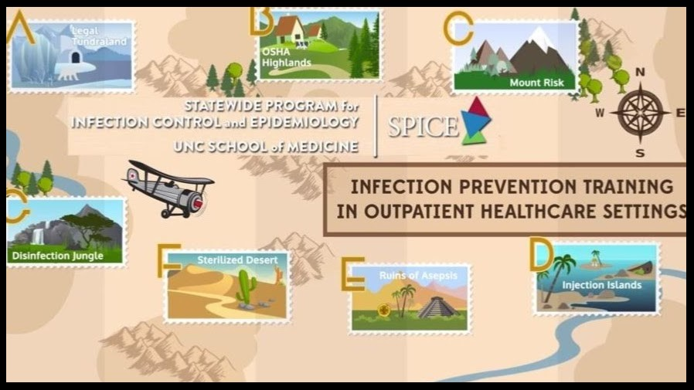

Slide 2
Hospital workers safety precaution program
Key problems the program is going to address
Health workers are always exposed to infections in hospitals. The transmissible diseases can easily affect the health workers and the patients in the health center; such infectious diseases include, Coronavirus, flue, Hepatitis A, and B, and many others. If the health workers are infected, the rate of infection can increase in the health facility. Health care services might be paralyzed, thus affecting the patients' well-being (Jung, 2018).
The program was designed to reduce the hospitals' rate of infections by reducing the diseases' exposure to health workers. Key precaution steps will be addressed in this program to control disease infection in health care.

Slide 3
Information of the program
This is a training program whose primary goal is to control disease infection in the health care facility. Many reasons can lead to an increase of infections in hospitals, such as using contaminated instruments, low maintenance of the ventilators, and reuse of the syringes and needles (Bahl et al., 2020). Ignorance from the health workers is also contributing to the increase of infection in the health care facility—for example, ignorance to wash hands or wear protective gloves.

Slide 4
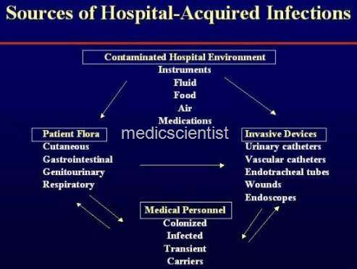
Sources of hospital infections

Slide 5
Ways to manage hospital infections
Hospital infections can be controlled by preventive measures, which are providing the required precautions to prevent the exposure of the infections.
Two types of precautions are supposed to be used in hospitals, depending on the types of diseases. The standard precautions and additional ( transmission primary based ) precautions. Both precautions address the highly infectious diseases and those that are not (Yu and Yang,2017).

Slide 6
Standard precautions
Standard precautions
They are precautions taken by the health workers while working on the patients. The health care workers should assume that all patients' blood and frame substances are capability sources of infection, regardless of the prognosis or presumed infectious fame. These precautions are to be taken by every health worker despite the patient's conditions (Yu and Yang,2017).
They aim at minimizing the risk of transmission of infections, especially ones transmitted by blood. They also apply to all patients regardless of their health status. They are to be practiced when handling the following, blood, mucous membranes, and body fluids.

Slide 7
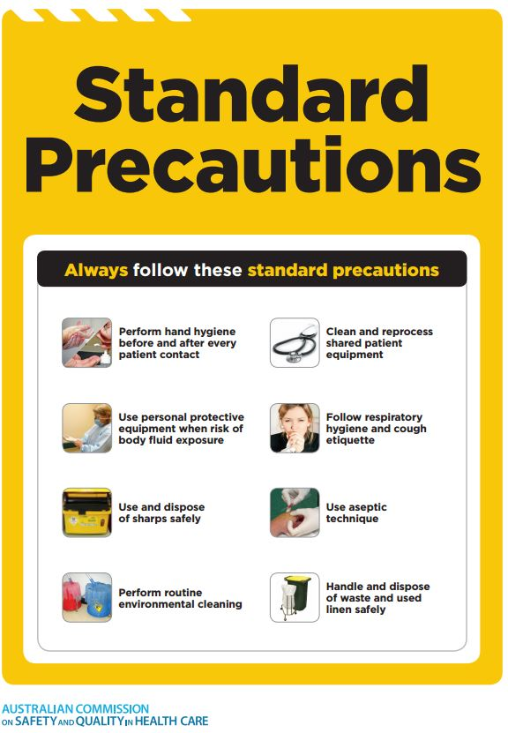
Standard precautions

Slide 8
Transmission – primary based precautions
The transmission-based precautions are also called additional standard precautions; they add more preventive measures to infectious diseases.
Highly infectious diseases such as HIV/AIDS, COVID 19, Hepatitis C virus, and flu can be easily transmitted from the patients to healthcare workers. The additional standard precautions are made depending on the type of virus transmissions, such as airborne transmission diseases such as tuberculosis and contact transmission such as Coronavirus (Yu and Yang,2017). It is based on wearing protective gear to prevent health workers from being exposed.

Slide 9
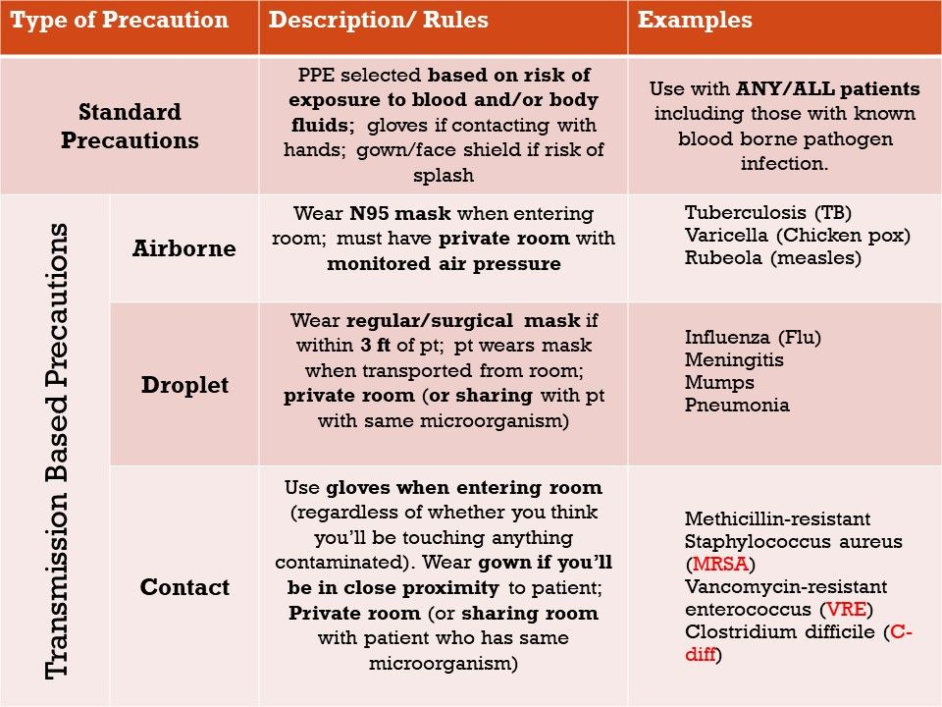
Transmission –primary based precautions

Slide 10
Guidelines for essential precautions
Some of the precautions are very sensitive to the health workers; if they don’t take precautions, the risk of infection will be high. They are hand hygiene, personal protective equipment, and environmental control; they are both classified as additional and standard precautions.
Environmental control and procedures; the hospital environment can be highly infectious if it is not maintained. Environmental control procedures involve disinfection and cleaning of the health facility surfaces, beds—proper waste disposal, and management.

Slide 11
Guidelines for essential precautions
Use of the protective equipment helps health workers from being exposed to substances that can cause infections procedure and equipment Gloves; wear a single glove, sterilize your gloves, remove the gloves after the procedure, and hand washes. The Gowns and aprons are supposed to protect health workers from exposure to infections. Wear masks for eye protection and face shields.
The figure below shows an example of protective gear.

Slide 12
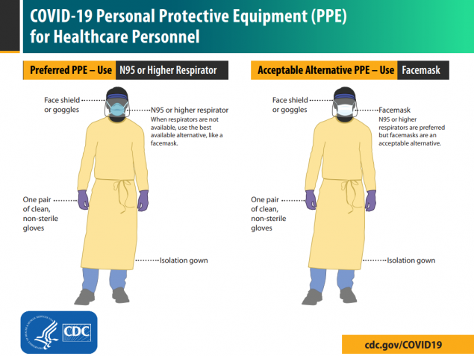
Guidelines for essential precautions

Slide 13
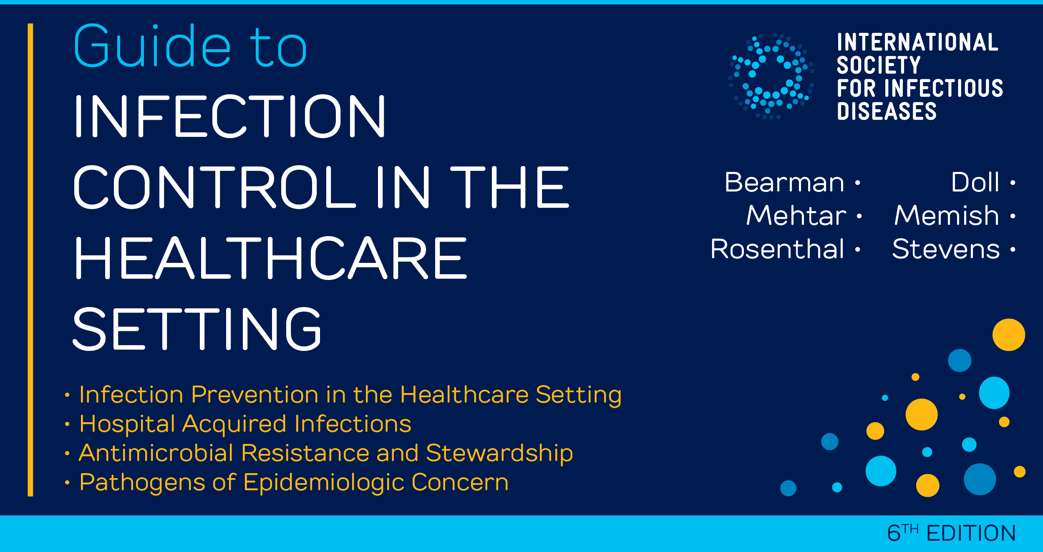

Slide 14
The plan to implement the program
Provision of the protective measures
Protective measures such as gloves, PPE will be bought for the health workers. The hospital cleaners will be cleaning the hospital's surfaces and providing new washed bed equipment every day. The health workers will be encouraged to use protective gear. The health workers will be taught how to use protective gear effectively.

Slide 15
Plan to monitor the success of the program
The success of the program will be monitored with the heads of every department in the health facility. The department heads will ensure before the health workers in their department use the protective measures when handling patients. The reports of the hospital infections will be used to measure the success of the program. If the infections are less in the hospital, the program will be seen as a success.

Slide 16
The impact of the program to the facility
The training program is going to control the spread of the infection in the health facility. The health workers will be educated on how to protect themselves and also to protect the patients. The hospital operations will continue to be successful without disruptions due to infections.

Slide 17
The program current practices and how they adhere to the state national rules
The current program practices, especially this time of COVID 19, ensure that the health workers wear protective gear. The places for highly infectious diseases are separated from the rest of the hospital operations. There are cleaning and disinfection of the surfaces, beds, and places people use most of the time. The program precautions stipulated are under the health policies for the health workers' safety against infections provided by CDC this time of coronavirus (Park et al., 2020).

Slide 18
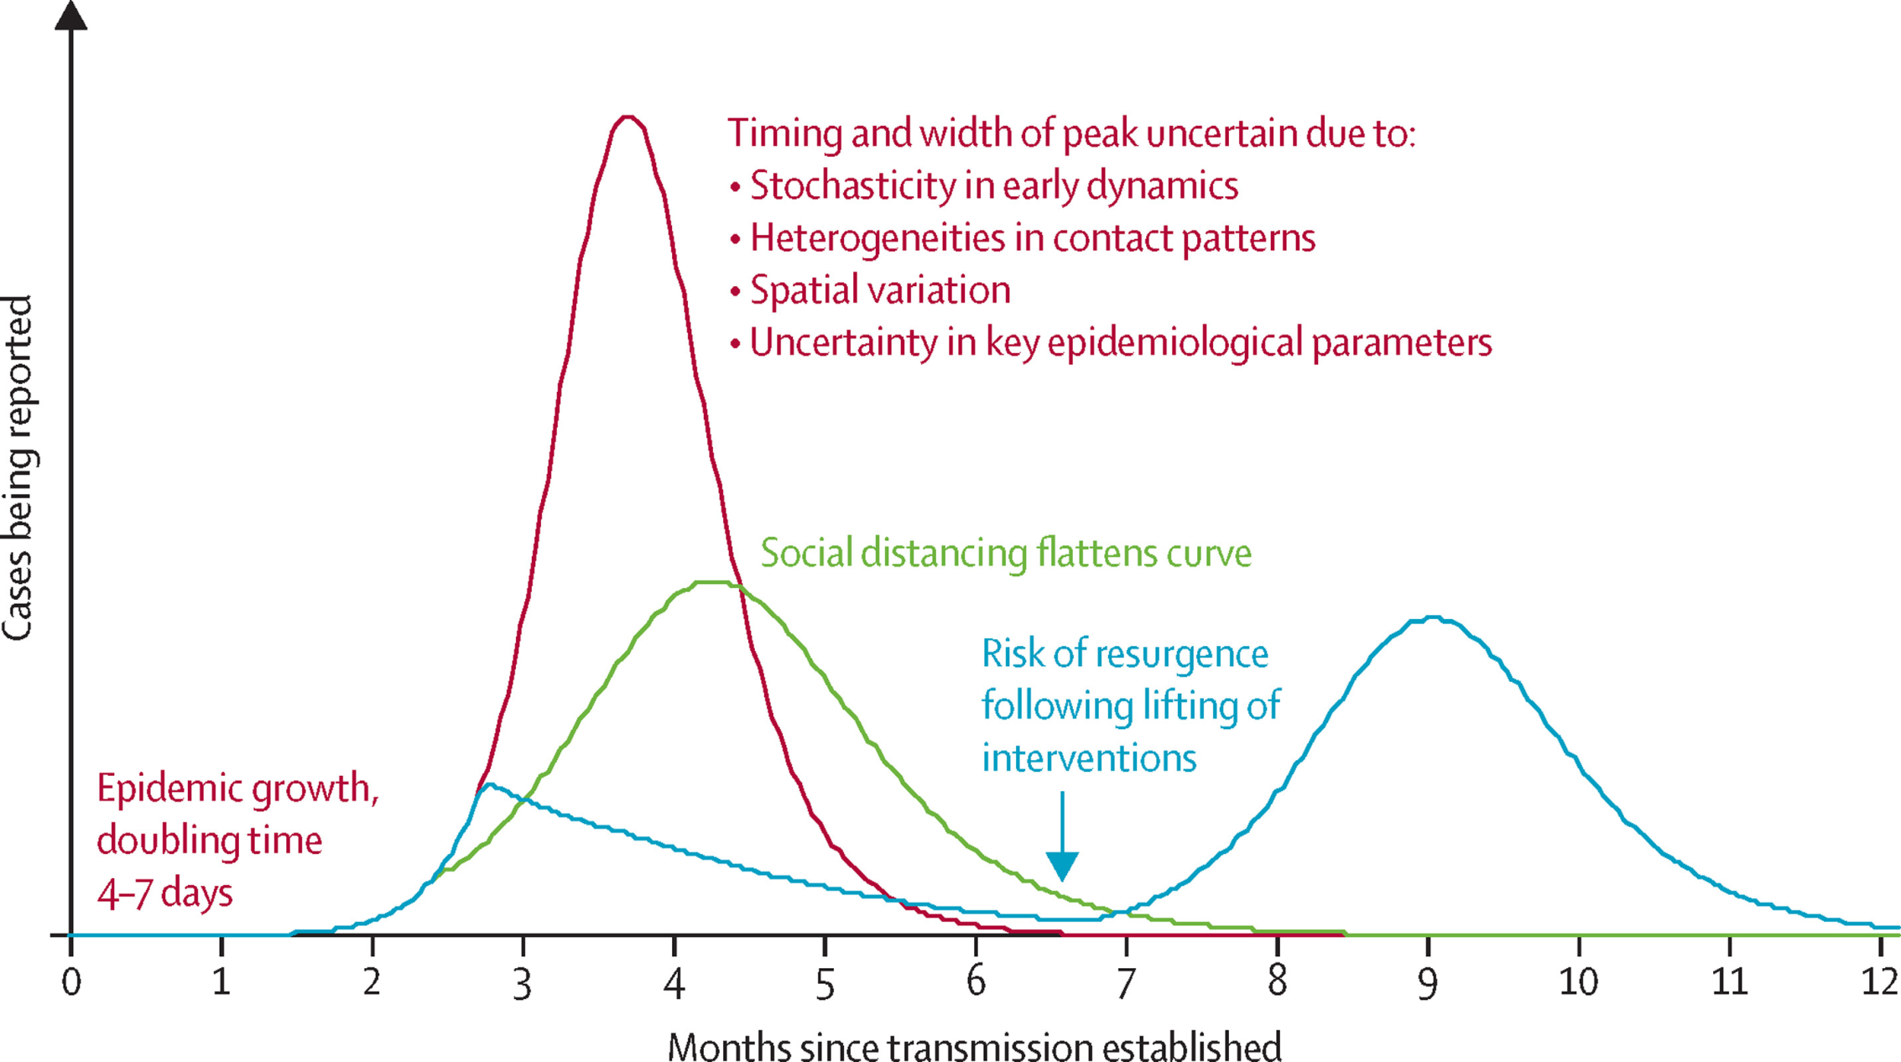

Slide 19
References
Jung, M. R. (2018). Effects of empowerment and regarding standard precautions for healthcare associated infection control in healthcare workers on performances. Journal of Digital Convergence, 16(2), 243-250.
Bahl, P., Doolan, C., de Silva, C., Chughtai, A. A., Bourouiba, L., & MacIntyre, C. R. (2020). Airborne or droplet precautions for health workers treating COVID-19?. The Journal of infectious diseases.
Yu, J. W., & Yang, N. Y. (2017). Characteristics and Knowledge of Needlestick Injuries and Compliance with Standard Precautions in Healthcare Workers. Journal of Korean Academic Society of Home Health Care Nursing, 24(3), 275-283. Park, C. L., Russell, B. S., Fendrich, M., Finkelstein-Fox, L., Hutchison, M., & Becker, J. (2020). Americans’ COVID-19 Stress, Coping, and Adherence to CDC Guidelines. Journal of General Internal Medicine, 1.

